Slide 1
Container Data Structures
Mr. Channa Bankapur

Slide 2
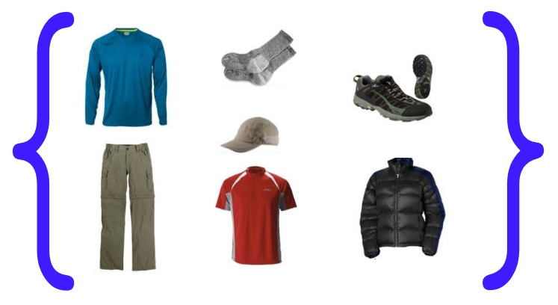
Data Structures - Containers
A set is a discrete mathematical structure that holds a bunch of items. There are many popular data structures implementing the set discrete structure. The following are some of the most common methods on such a data structure.
Create/Insert a new item
Read/Retrieve/Search an item
Update/Modify an item
Delete/Remove an item

Slide 3
What is an item?
The data structure can hold objects of arbitrary complexity.
One field or a combination of several fields in each item is used as the key field for inserting, searching and deleting.
E.g. In a data structure containing
employee records, the employee id serves as the key.
profiles of users for an online service, the userid/username serves as the key.

Slide 4
Problem: An Archival System
Suppose, we have an archival system, which needs to optimize on inserting a new item into the container. Retrieval and deletion are rare, and are not on optimal path.
Let us see if arrays are any good as containers!
What is an array, BTW?

Slide 5
Array as a container
An array is stored such that the position of each element can be computed from its index (key) by a mathematical formula.
An array is a sequence of elements that are typically stored in contiguous memory locations.
Position of a[i] = (position of a) + i *(size of each element)

Slide 6
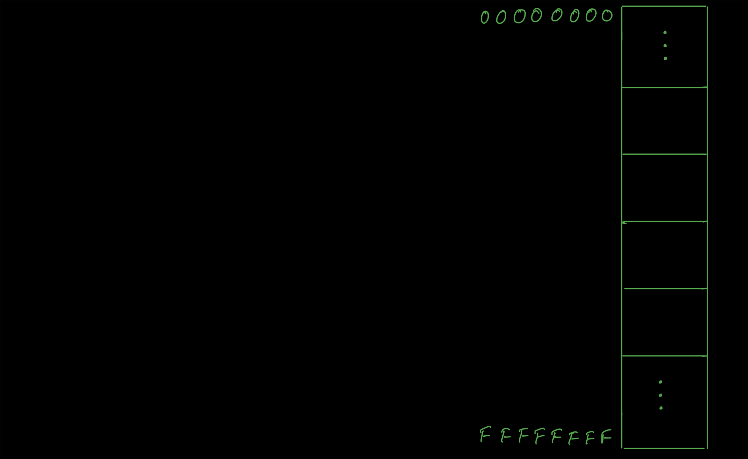

Slide 7
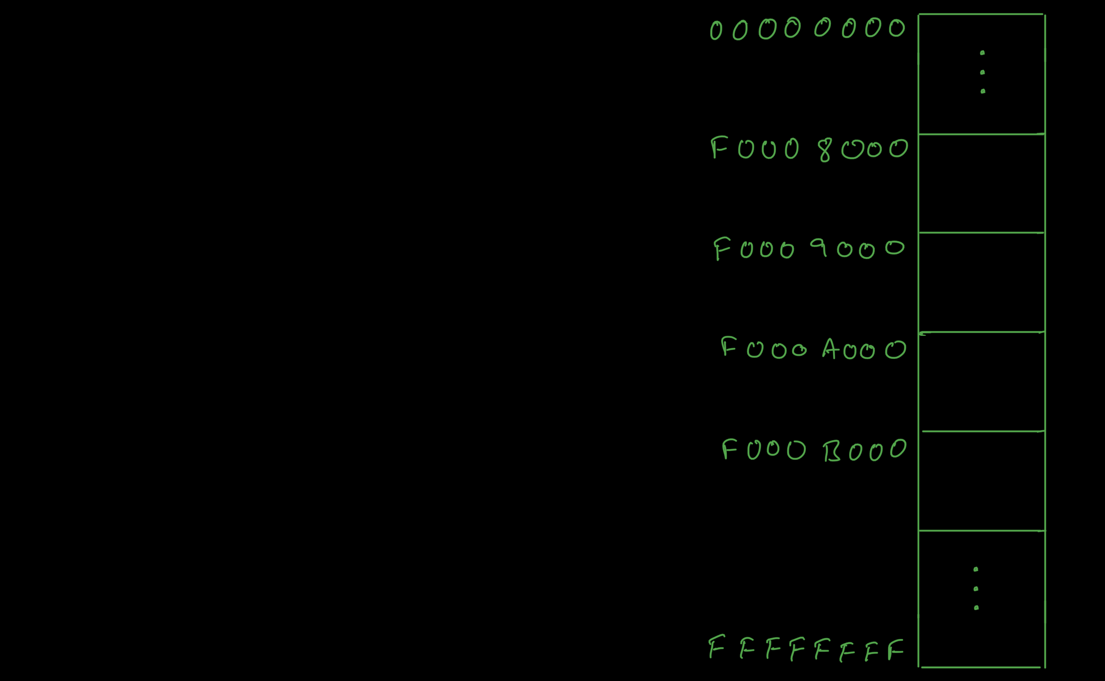

Slide 8
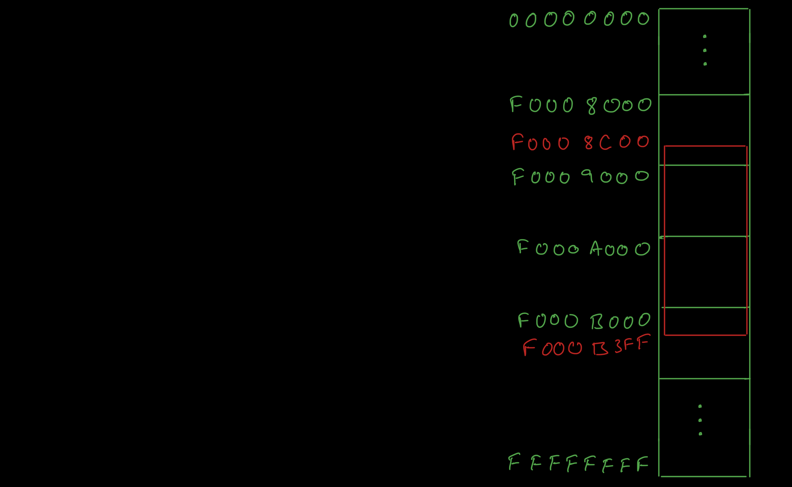

Slide 9
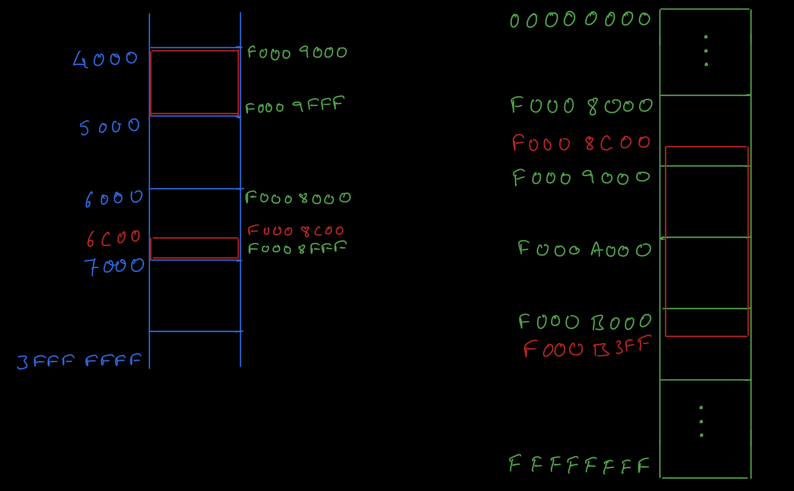

Slide 10
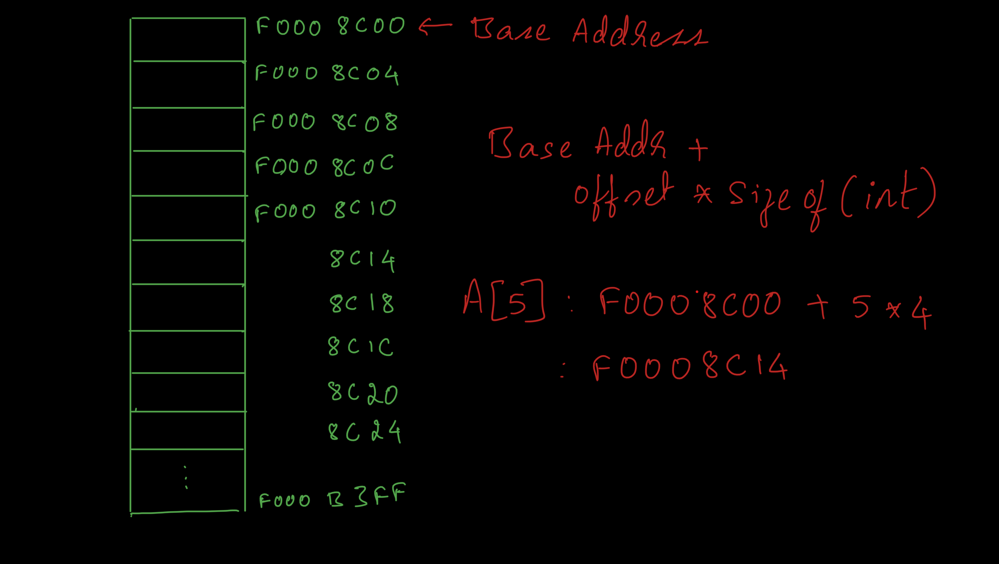

Slide 11
Array as a container
Insert(ele): inserting a new element into the collection
Retrieve(key): finding an element matching the given key
Delete(key): deleting an element matching the given key
Insert: O( ? )
Retrieve: O( ? )
Delete: O( ? )

Slide 12
Array as a container
Insertion can be done at the end.
Unsorted arrays need a slow linear search for retrieval.
Deleting an element requires seeking the position of the element and filling the hole.
Insert: O(1) ← insertion is optimized!
Retrieve: O(n)
Delete: O(n)
In the archival system, insertion operation was on the optimal path, and hence we met the objective.

Slide 13
Array as a container
Insertion can be done at the end.
Unsorted arrays need a slow linear search for retrieval.
Deleting an element requires seeking the position of the element and filling the hole.
Insert: O(1)
Retrieve: O(n) ← what if this method needs to be optimized?
Delete: O(n)
Eg: An server responding to queries is in the optimal path, while insertion and deletion are in non-optimal paths.

Slide 14
Sorted/Ordered Array as a container
Arrays may be sorted by their key field, and this improves the search time drastically using binary search.
Insert: O( ? )
Retrieve: O( logn )
Delete: O( ? )

Slide 15
Sorted/Ordered Array as a container
Arrays may be sorted by their key field, and this improves the search time drastically using binary search.
Inserting and deleting an element require creating or filling a hole respectively and thus involve shifting other elements.
Insert: O( n )
Retrieve: O( log n ) ← retrieval is optimized!
Delete: O( n )

Slide 16
Sorted/Ordered Array as a container
Arrays may be sorted by their key field, and this improves the search time drastically using binary search.
Inserting and deleting an element require creating or filling a hole respectively and thus involve shifting other elements.
Insert: O(n)
Retrieve: O(log n)
Delete: O(n)
Creating and filling a hole is because of the contiguity requirement of an array.
Can we get rid of creating and filling a hole?

Slide 17
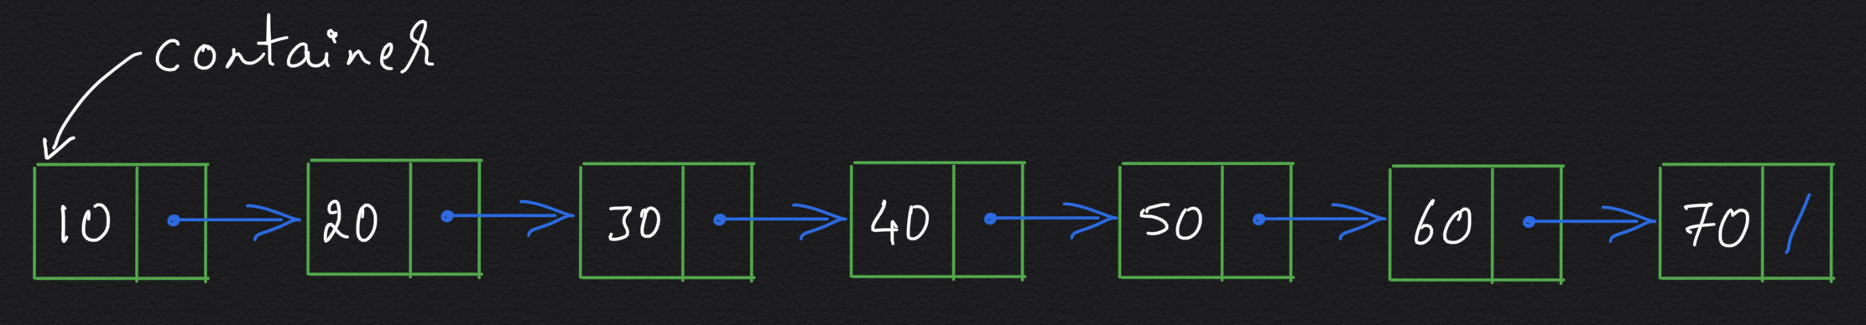
Linked List (unordered)
To avoid the problem of shifting the elements during insertion and deletion, the requirement for storing elements contiguously is relaxed.
This leads to the concept of a linked list where the addresses of elements are maintained within the data structure itself.
Insert: O( ? )
Retrieve: O( ? )
Delete: O( ? )

Slide 18
Linked List (unordered)
To avoid the problem of shifting the elements during insertion and deletion, the requirement for storing elements contiguously is relaxed.
This leads to the concept of a linked list where the addresses of elements are maintained within the data structure itself.
Searching requires a slow walk of the linked list.
Insert: O(1)
Retrieve: O(n)
Delete: O(n)

Slide 19
Linked List (unordered)
To avoid the problem of shifting the elements during insertion and deletion, the requirement for storing elements contiguously is relaxed.
This leads to the concept of a linked list where the addresses of elements are maintained within the data structure itself.
Searching requires a slow walk of the linked list.
Insert: O(1)
Retrieve: O(n) ← let us see if keeping the list sorted helps!
Delete: O(n)

Slide 20
Sorted/Ordered Linked List
Searching arrays was hastened by keeping the elements sorted and then using the technique of binary search.
Applying a similar idea to a linked list leads to the sorted linked list.
Insert: O( ? )
Delete: O( ? )
Retrieve: O( ? )

Slide 21
Sorted/Ordered Linked List
Searching arrays was hastened by keeping the elements sorted and then using the technique of binary search.
Applying a similar idea to a linked list leads to the sorted linked list.
Unfortunately the search operation is still quite slow because binary search, as we know it, is not helping.
Insert: O(n)
Delete: O(n)
Retrieve: O(n) ← sortedness of the linked list did not help!

Slide 22
Sorted Linked List
Why does binary search won’t work on a sorted linked list?

Slide 23
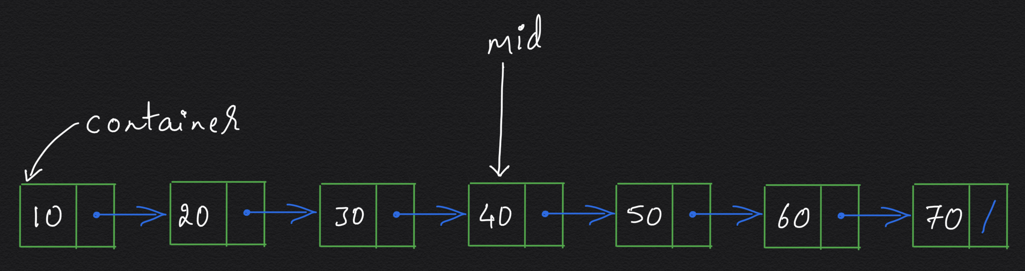
Why does binary search won’t work on a sorted linked list?
We need random access to the middle item.
Does binary search work on a sorted linked list if we have a reference to the middle item of the sorted linked list?

Slide 24
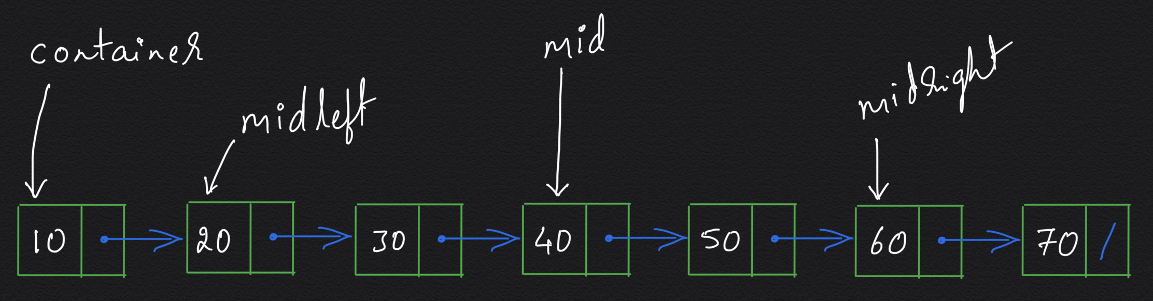
Does binary search work on a sorted linked list if we have a reference to the middle item of the sorted linked list?
We need random access to the middle item of left half and right half.

Slide 25
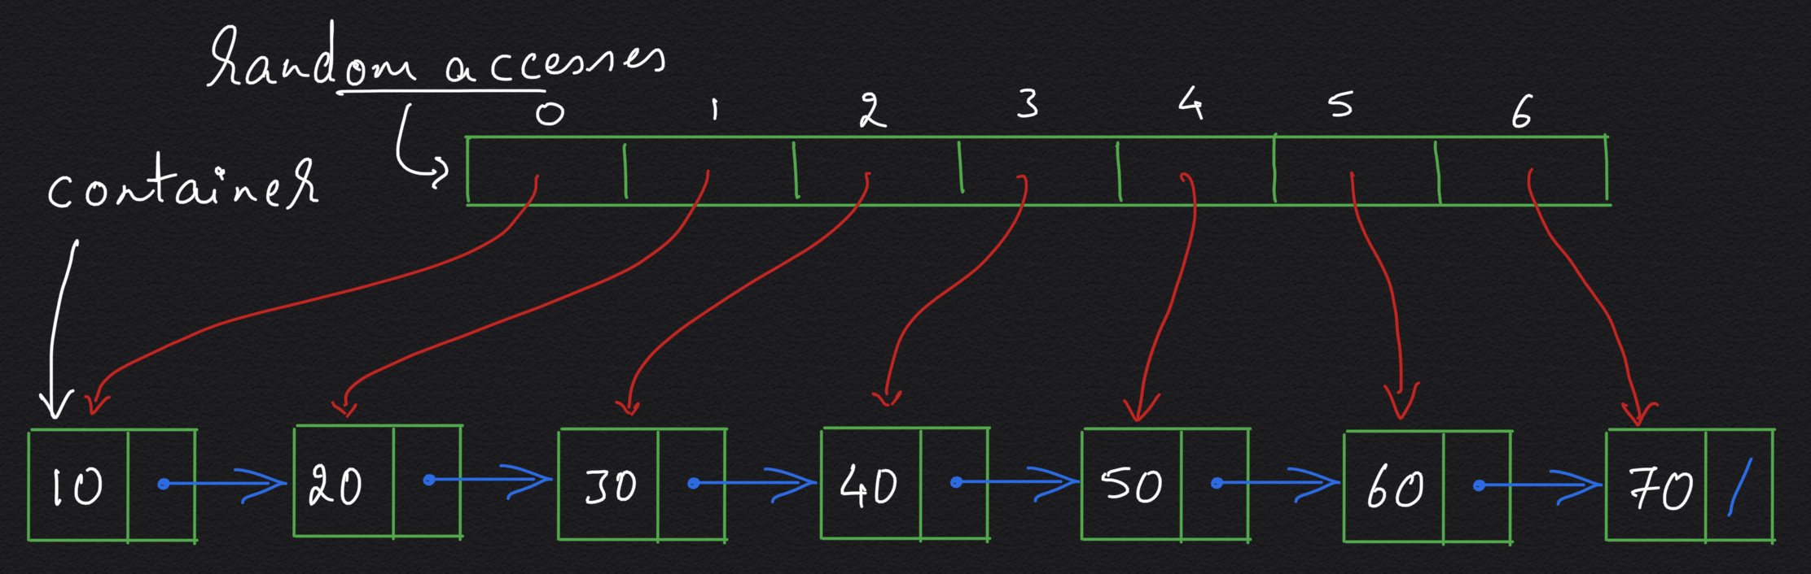
Does binary search work on a sorted linked list if we have random access to all the items as an array of references?
Can we now search for an item in O(log n) time?

Slide 26
We can search in O(log n) time if we have an array of references to all the items in the sorted linked list.
Are we back to a sorted array that has to deal with creating and filling a hole in the sorted references?

Slide 27
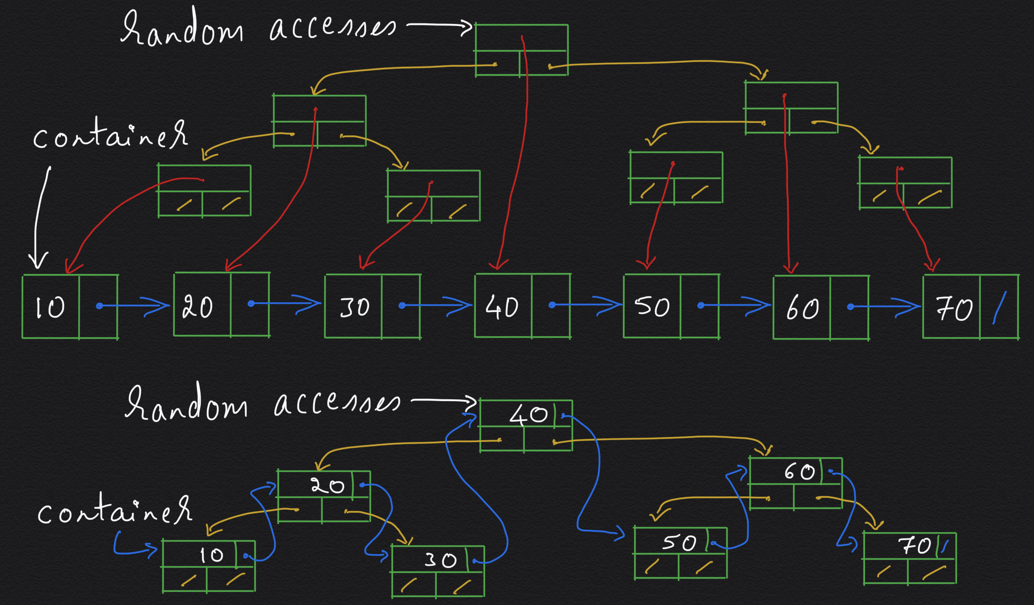

Slide 28
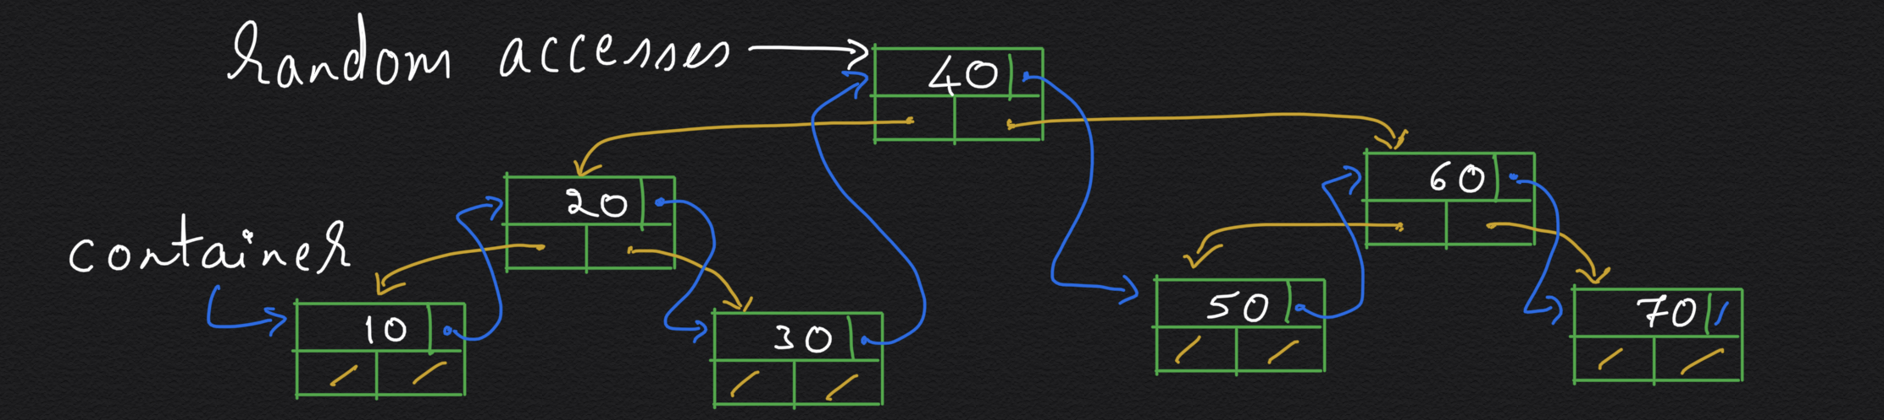
Sorted Linked List → BST with log(n) height
BST is a Binary Tree where …
What we have here is a Complete Binary Search Tree (BST)
Retrieve: O(log n)
Insert: O(?)
Delete: O(?)

Slide 29
Binary Search Tree (BST) with O(log n) height
Retrieve: O(log n)
Insert: O(log n) ← is this possible?
Delete: O(log n) ← is this possible?
Yes, for example,
AVL Trees
Red-Black Trees

Slide 30
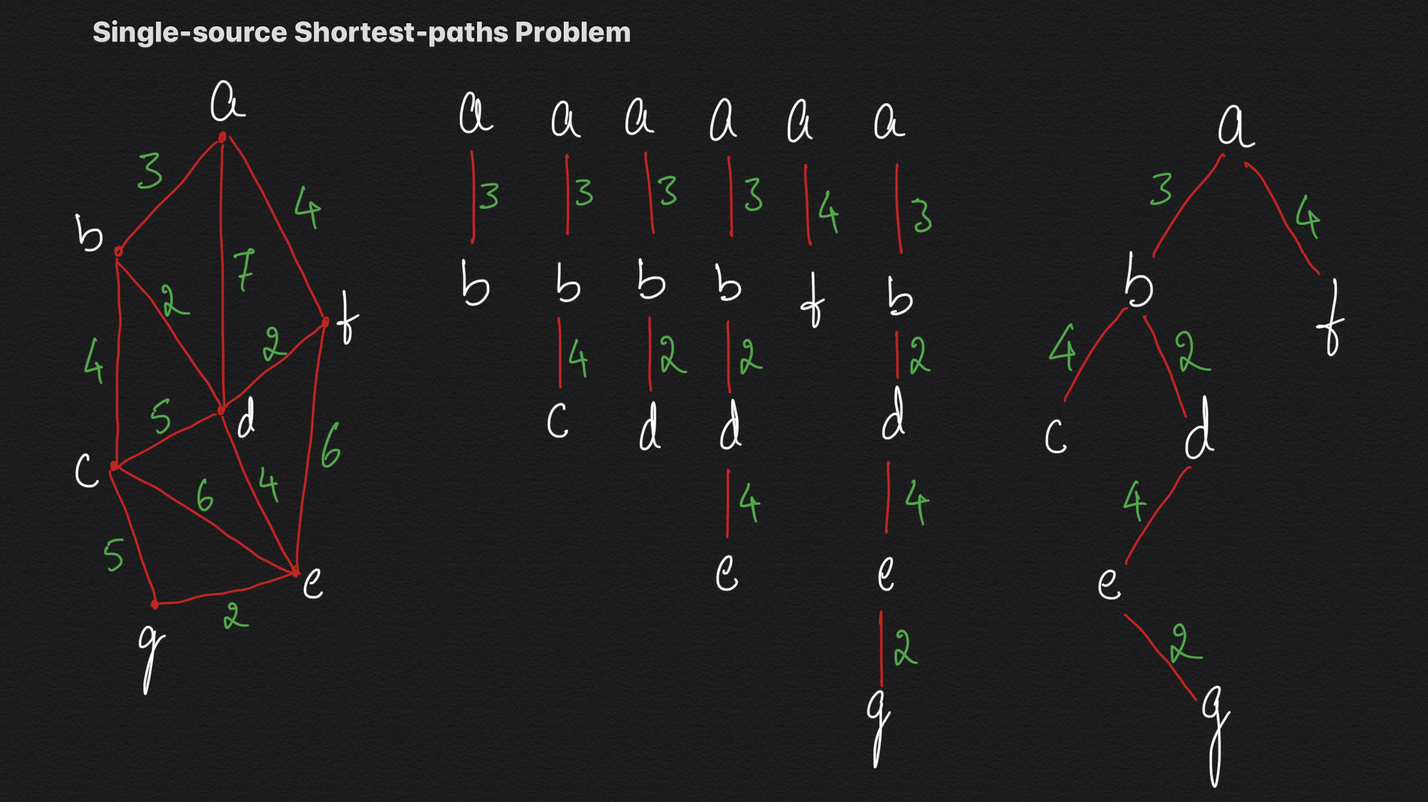

Slide 31
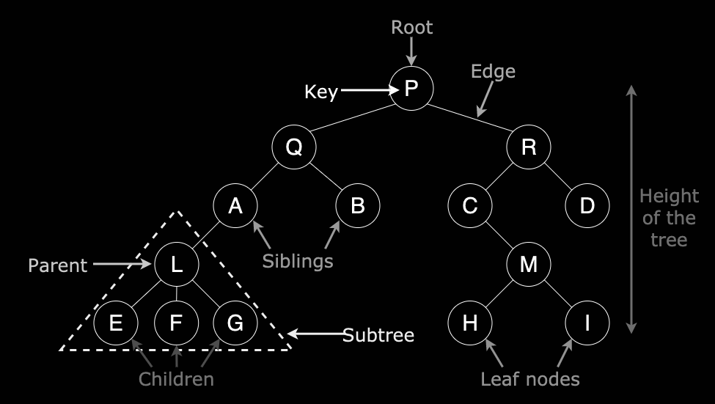
Trees
Tree is a connected
acyclic graph.
A tree is non-linear and a
hierarchical data structure
consisting of a collection
of nodes such that each node of the tree stores a value and a list of references to other nodes (the “children”).
A tree consists of a root, and zero or more subtrees. There is an edge from the root to the root of each subtree.

Slide 32
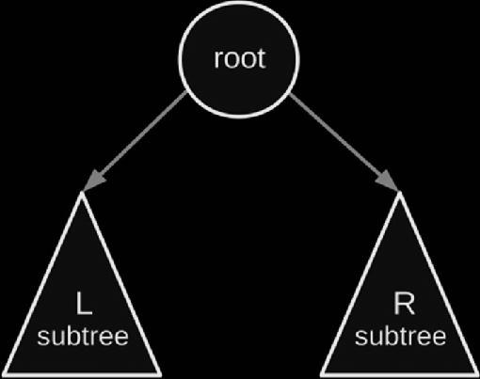
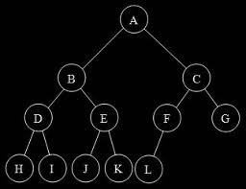
Binary Trees
A binary tree is a tree data structure in which each node has at most two children, which are referred to as the left child (left subtree) and the right child (right subtree).

Slide 33
Binary Trees
Insert: O(1)
Retrieve: O(n)
Delete: O(n)
If it were a complete binary tree, what happens to Retrieve()?
In a complete binary tree, every level, except possibly the last, is completely filled. The height of such a tree is log(n).

Slide 34

Binary Search Trees (BST)
A BST satisfies the binary search property, which states that the key in each node must be ≥ any key stored in the left subtree, and ≤ any key stored in the right subtree.
Insert: O( ? )
Delete: O( ? )
Retrieve: O( ? )

Slide 35

Binary Search Trees (BST)
A binary search tree satisfies the binary search property.
The shape of the binary search tree depends on the order of insertions and deletions, and can become degenerate.
Insert: O(height) = O(n)
Delete: O(height) = O(n)
Retrieve: O(height) = O(n)
Doesn’t it remind of the sorted linked list?
Problem: Validate if the given binary tree is a BST.

Slide 36

Balanced Binary Search Trees:
Time complexity of worst-case of search in a BST is O(n)
If we can we keep the BST balanced (that is, the height of the tree is limited to O(log n)), then the worst-case of search will be in O(log n).

Slide 37
Balanced BST
A balanced binary tree is a binary tree in which the height of the tree is O(log n).
Balanced BSTs avoid getting skewed in either direction.
Insert: O(log n)
Delete: O(log n)
Retrieve: O(log n)
Eg: Balanced BST
AVL Trees, Red-Black Trees, Splay Trees (Amortized)
Eg: Balanced Search Trees
2-3 Trees, 2-3-4 Trees, B Trees, B+ Trees

Slide 38
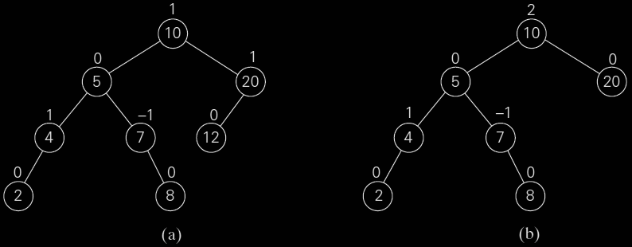
AVL Trees: An AVL tree is a BST in which the balance factor of every node is either 0, +1 or -1.
Balance factor: The difference between the heights of the node’s left and right subtrees.

Slide 39
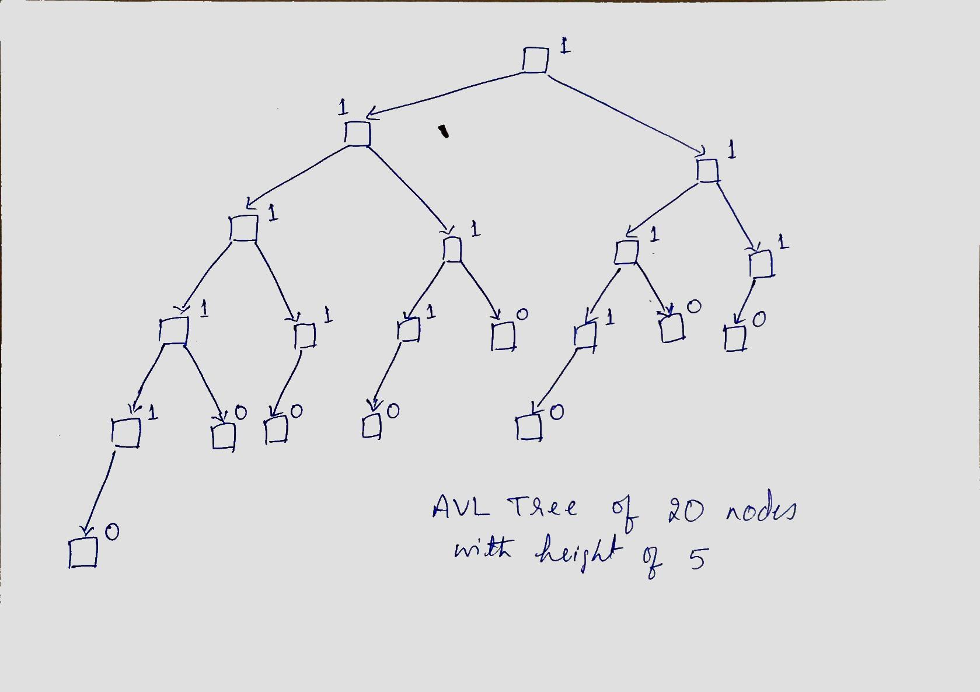
AVL Tree:
Insert
O(logn)
Delete
O(log n)
Retrieve
O(log n)

Slide 40
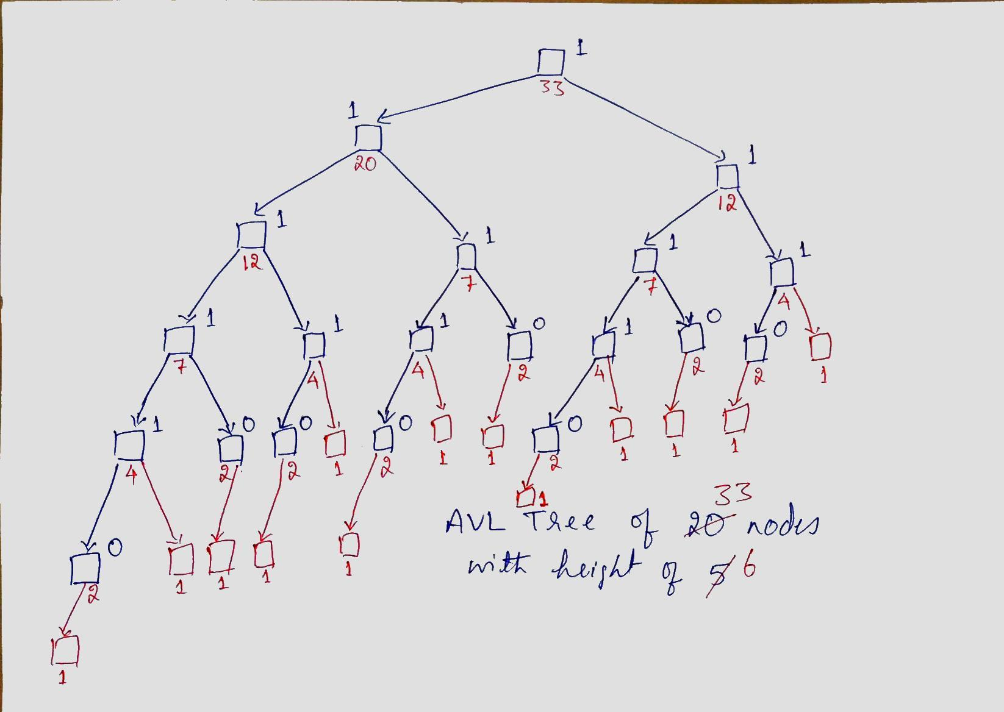
AVL Tree:
Insert
O(logn)
Delete
O(log n)
Retrieve
O(log n)

Slide 41
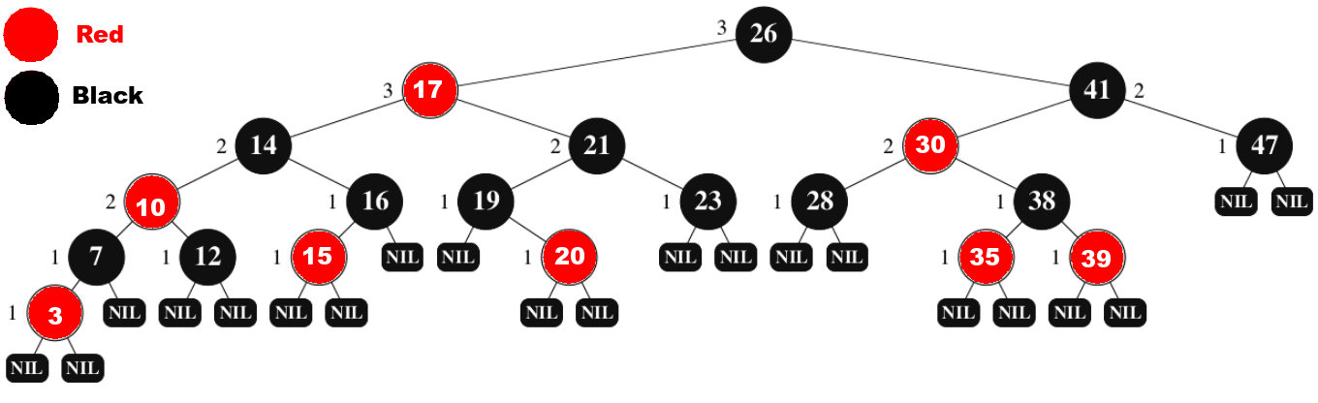
Red Black Tree
A red-black tree is a binary search tree with one extra bit of storage per node: its color, which can be either RED or BLACK.
By constraining the node colors on any simple path from the root to a leaf, red-black trees ensure that no such path is more than twice as long as any other, so that the tree is approximately balanced.

Slide 42
Red Black Tree
Longest path from root to a leaf = h
Shortest path from root to a leaf >= h/2
Because the # red nodes < # of black nodes
How does it imply h = O(log n) ?
Longest path >= log n
h >= log n
Shortest path <= log n
Because all non-leaf nodes have two children nodes
h/2 <= log n
h <= 2 * log n
h <= log n <= h
log n <= h <= 2 * log n
h = O(log n)

Slide 43
Hash Table
Insert: O(1)
Delete: O(1)
Retrieve: O(1)
* conditions apply
Is Hash Table that good?
Is it really O(1)?

Slide 44
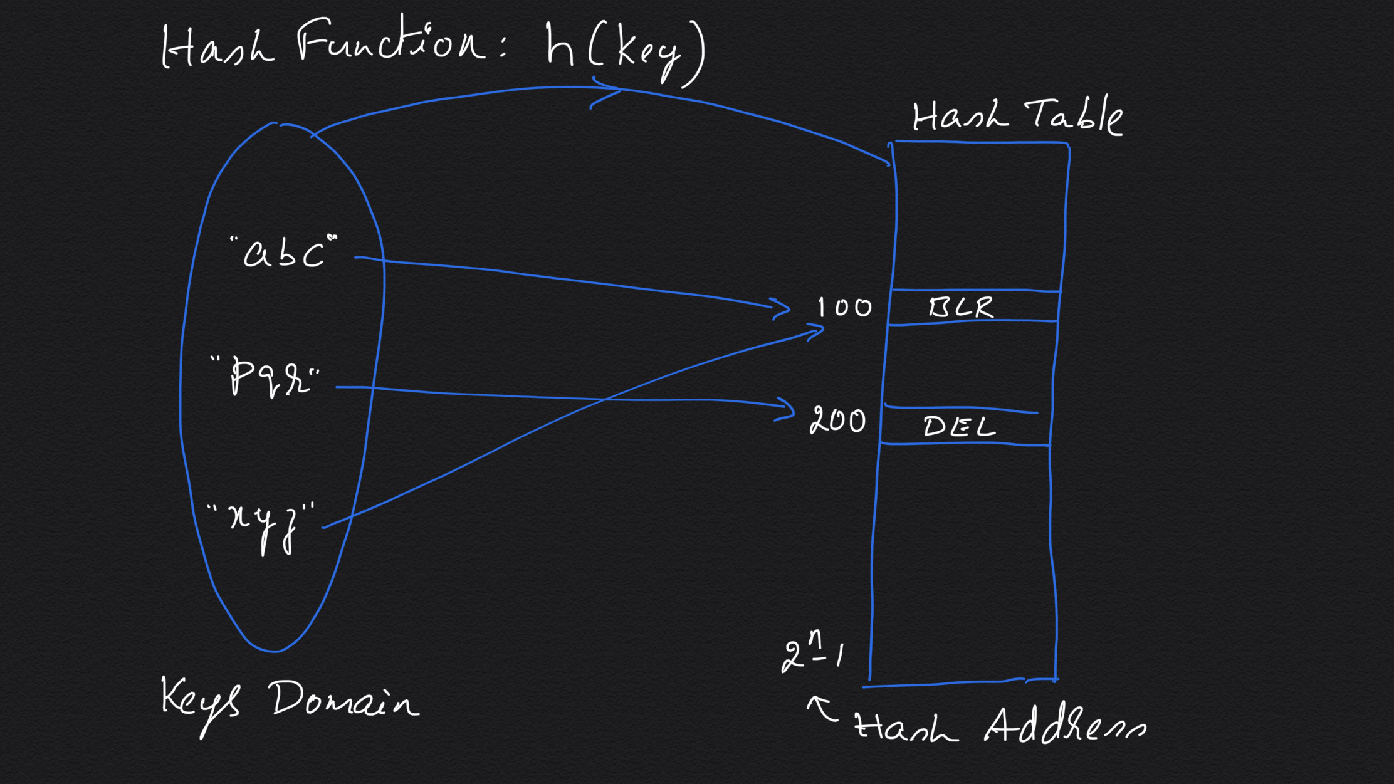

Slide 45
Hash Table
In separate chaining, a linked list of entries all of which map to the same hash bucket is maintained.
If the chosen hash function is not good, then it is possible that the linked lists get very long.
In open addressing, all the entries are stored in the hash table itself; when a collision occurs, another free slot is found by following a probe sequence, e.g. linear probing.
Insert/Retrieve/Delete: O(1) amortized

Slide 46
Hash Table
Hash table provides the feel of an array.
Can we call hash table as an array?

Slide 47
Hash Table
Hash table provides the feel of an array.
Can we call hash table as an array?
Hash tables are a kind of associative arrays.
Associative arrays retrieve Arr[name] just the way we retrieve i^{th} item in a regular array as Arr[ i ].
Can we retrieve Arr[name] in constant time just the way we retrieve i^{th} item in an array as Arr[ i ] in constant time?

Slide 48
Hash Table
Hash table provides the feel of an array.
Can we call hash table as an array?
Hash Tables are a kind of associative arrays.
Balanced BSTs and TRIEs are also associative arrays.
Associative arrays retrieve Arr[name] just the way we retrieve i^{th} item in a regular array as Arr[ i ].
Can we retrieve Arr[name] in constant time just the way we retrieve i^{th} item in an array as Arr[ i ] in constant time?
Insert/Retrieve/Delete: O(1) amortized
AVL tree: Insert/Retrieve/Delete: O(logn) worst-case

Slide 49
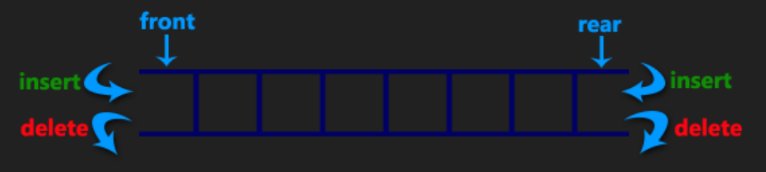
Chain of identical items
Stock of identical items where there is always a single chain of items in the container.
Insert: O(?) ← insertFront(), insertRear()
Retrieve: O(?) - getFront(), getRear()
Delete: O(?) - deleteFront(), deleteRear()

Slide 50
Double Ended Queue (Deque)
A double ended queue (deque) has a chain of items wherein the insertions and deletions can both occur at either end.
Insert: O(1) - insertFront(), insertRear()
Retrieve: O(1) - getFront(), getRear()
Delete: O(1) - deleteFront(), deleteRear()

Slide 51
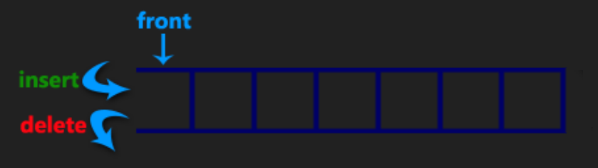
Stack
A stack is a chain of items where insertions and deletions are done at only one end.
A stack is a last-in-first-out (LIFO) data structure, wherein the last item inserted is the one to be deleted.
Insert: O( ? )
Delete: O( ? )
Retrieve: O( ? )

Slide 52
Stack
Insertions (pushes) and deletions (pops) both happen at the same end, aka top of the stack.
A stack is a last-in-first-out (LIFO) data structure, wherein the last item inserted is the one to be deleted.
Insert: O(1) ← insertFront()
Retrieve: O(1) - getFront()
Delete: O(1) - deleteFront()

Slide 53
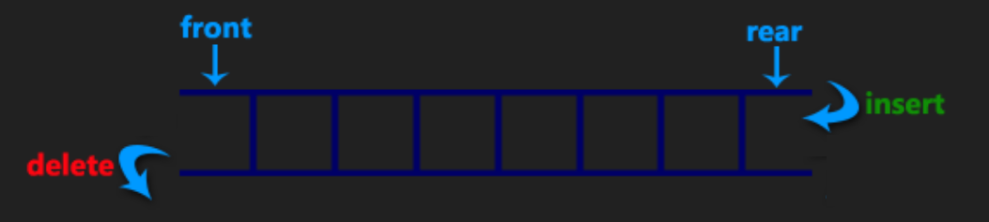
Queue
A queue is a chain of items where insertions and deletions are done at opposite ends.
Insertions (enqueues) occur at one end and deletions (dequeues) happen at the other end.
Insert: O( ? ), Delete: O( ? ), Retrieve: O( ? )

Slide 54
Queue
A queue is a first-in-first-out (FIFO) data structure, wherein the first element inserted is the first to be deleted.
Insertions (enqueues) occur at one end and deletions (dequeues) happen at the other end.
Insert: O(1) ← insertRear()
Retrieve: O(1) - getFront()
Delete: O(1) - deleteFront()

Slide 55
Problem Description:
Implement a queue using two stacks.

Slide 56
Solution 1: Stack1 is the queue and Stack2 is a helper
enQueue(q, x):
Push x onto Stack1. (top of Stack1 is the rear end of the queue)
deQueue(q):
While stack1 is not empty, push everything from Stack1 to Stack2.
Pop the top element from Stack2.
Push everything back to Stack1.
In this solution, each element is pushed twice and popped twice during every enqueue operation.
Enqueue time complexity = O(1).
Dequeue time complexity = O(n), where n is the maximum number of elements in the queue.

Slide 57
Solution 2: Use tops of the stacks as ends of the queue
enQueue(q, x):
Push x to stack1. (top of Stack1 is the rear end of the queue)
deQueue(q):
If both stacks are empty then error.
If Stack2 is empty:
While stack1 is not empty, push everything from Stack1 to Stack2.
Pop the element from Stack2 and return it.
In this solution, each element is moved once; further, each element is moved only when stack 2 is empty.
Enqueue time complexity = O(1).
Dequeue time complexity = O(n), where n is the maximum number of elements in the queue.
Amortized cost is O(1).

Slide 58
Priority Queue
A priority queue is an extension of a queue in which each element has a priority defined.
The elements with higher priority are dequeued before the ones with lower priority.
Priority queue is also a chain of items where deletions are done at the priority end!
Priority queues are implemented using
An unsorted/sorted array: O(?), O(?), O(?)
An unsorted/sorted linked list: O(?), O(?), O(?)
An AVL tree: O(?), O(?), O(?)

Slide 59
Priority Queue
Priority queues are implemented using
An unsorted array: O(1), O(1), O(n)
Retrieval is O(1) when the priority element is kept track of.
A sorted array: O(?), O(?), O(?)
An unsorted linked list: O(?), O(?), O(?)
A sorted linked list: O(?), O(?), O(?)
An AVL tree: O(?), O(?), O(?)

Slide 60
Priority Queue
Priority queues are implemented using
An unsorted array: O(1), O(1), O(n)
Retrieval is O(1) when the priority element is kept track of.
A sorted array: O(n), O(1), O(1)
An unsorted linked list: O(?), O(?), O(?)
A sorted linked list: O(?), O(?), O(?)
An AVL tree: O(?), O(?), O(?)

Slide 61
Priority Queue
Priority queues are implemented using
An unsorted array: O(1), O(1), O(n)
Retrieval is O(1) when the priority element is kept track of.
A sorted array: O(n), O(1), O(1)
An unsorted linked list: O(1), O(1), O(n)
A sorted linked list: O(n), O(1), O(1)
An AVL tree: O(?), O(?), O(?)

Slide 62
Priority Queue
Priority queues are implemented using
An unsorted array: O(1), O(1), O(n)
Retrieval is O(1) when the priority element is kept track of.
A sorted array: O(n), O(1), O(1)
An unsorted linked list: O(1), O(1), O(n)
A sorted linked list: O(n), O(1), O(1)
An AVL tree: O(logn), O(1), O(logn)
A heap: O(logn), O(1), O(logn)

